Slide 1
Classical dynamics on a NN-interpolated PES
Andrés Marulanda-Bran

Slide 2
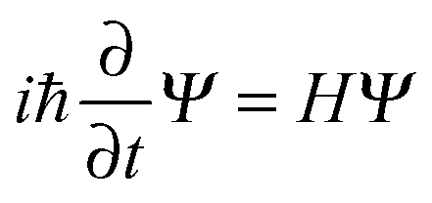
Simulations of molecular systems
Simulate how a molecular process (e.g. a chemical reactions, in general molecular dynamics) develops.
How?
Quantum, in principle (quite expensive however). Solve
Semiclassical
Classical (much cheaper but rough assumptions) Solve F = ma

Slide 3
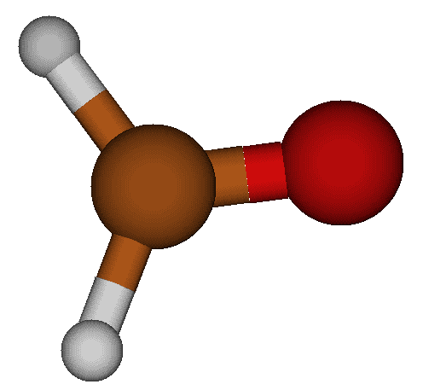
Classical dynamics
Just need to solve Newton’s equation F=ma for our system:
Assume atoms are hard spheres
They are in a force field (interactions)
The problem now reduces to find this force field!
Use some standard electronic structure methods (here, HF / cc-pVDZ)

Slide 4
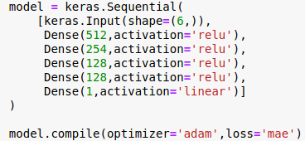
Force field
HF/cc-pVDZ although cheap for a ES method, is pretty expensive for a MD simulation.
We better interpolate a PES with few points.
NN:
Trained on 2000 points, get a val_loss of 0.0028 Hartree (~1.757 kcal/mol)
Chemical accuracy is 1 kcal/mol !
Moyano et. al. got 1.2 kcal/mol on test using other interp. method. [1]

Slide 5
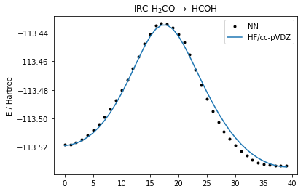
Results (PES slice)
This is a representative reaction: Isomerization between the two lowest energy states.
Results are good BUT weird shape at some points

Slide 6
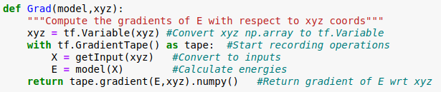
Side note: Gradients
The input to the NN are the inverse of the distances (1/R), but for MD we need the cartesian coords.
We calculate the gradient with the following function in TF

Slide 7
Results (trajectories)
Ground state, x₀’ = 0

Slide 8
Results (trajectories)
HCO + H collision, v₀ = 12000 m/s
HF (real gradients)
NN gradients

Slide 9
What next?
Use more data points
Sample from the trajectories themselves
Try to reproduce published results (such as [1])

Slide 10
Thank you!

Slide 11
References
[1] Gloria E Moyano, Seth A Jones and Michael A Collins. J Chem. Phys. 124, 12, 124-318 (2006). https://doi.org/10.1063/1.2181571

